Slide 1
Facial Recognition India Police Hackathon

Slide 2
Problem Statement
To create an algorithm to locate a missing person’s image in a provided search space.
Image dataset:
Missing Persons Images
Search Space datasets:
Wanted Persons Images
Arrested Persons Images
Unnatural Deaths Images
For every image present in the missing persons dataset, a suitable output has to be displayed to the user:
Successful Scenario: Images with the matched person, along with a confidence score.
Unsuccessful Scenario: A suitable error message.

Slide 3
Blockers
Numerous images in the provided datasets consist of a few blockers:
Tilted face of the person.
Blank images, full of whitespace.
Training samples of missing persons consist mainly of a single image leading a decrease in accurate detection of faces.

Slide 4
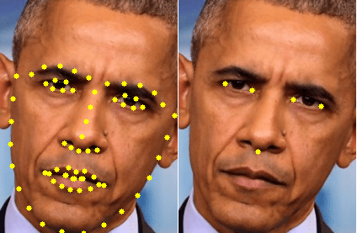
Proposed Solution – Choice Of Technology
Pre-processing the images to:
Straighten the face of any tilted image.
Cropping images to remove whitespaces.
To overcome the limitation of the single unique training image:
Increasing the number of facial landmarks from 5 to 68.
68 facial landmarks vs 5 facial landmarks

Slide 5
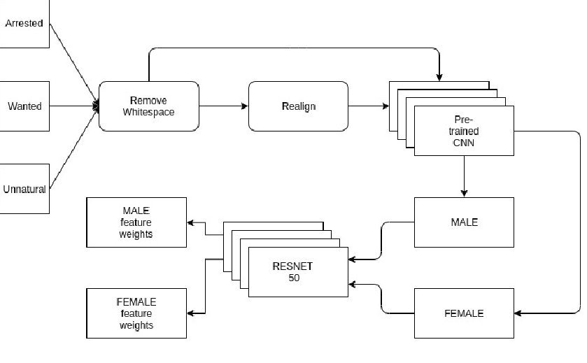
Current Architecture for Datasets:

Slide 6
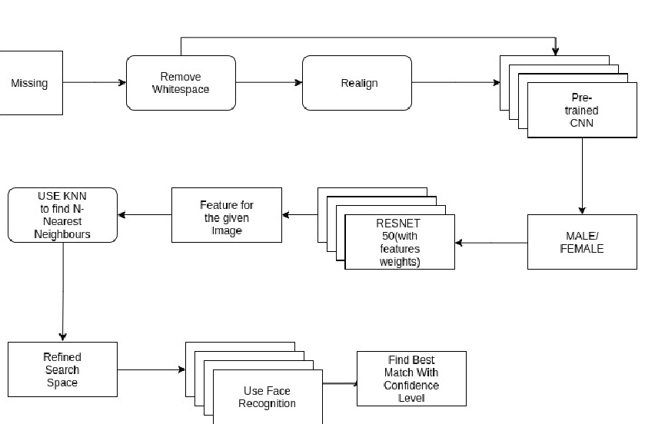
Architecture for recognition:

Slide 7
Working Examples:
81.78%
Arrested Database.
86.9%
Arrested Database
69.9%
Arrested Database

Slide 8
59.9%
Unnatural Death Cause
78%
Arrested Database

